Slide 1




Slide 2


Your Texas Benefits Online Application Overview
Presented by
Presented by Patrice Beckett-Cain
Care Connection Aging and Disability Resource Center

Slide 3



Learn How Your Texas Benefits Can Help You
Applying Online for Benefits is Fast and Easy.
https://www.yourtexasbenefits.com/Learn/Home
https://youtu.be/gpUxFnlkGhU, https://www.careconnection.org/

Slide 4
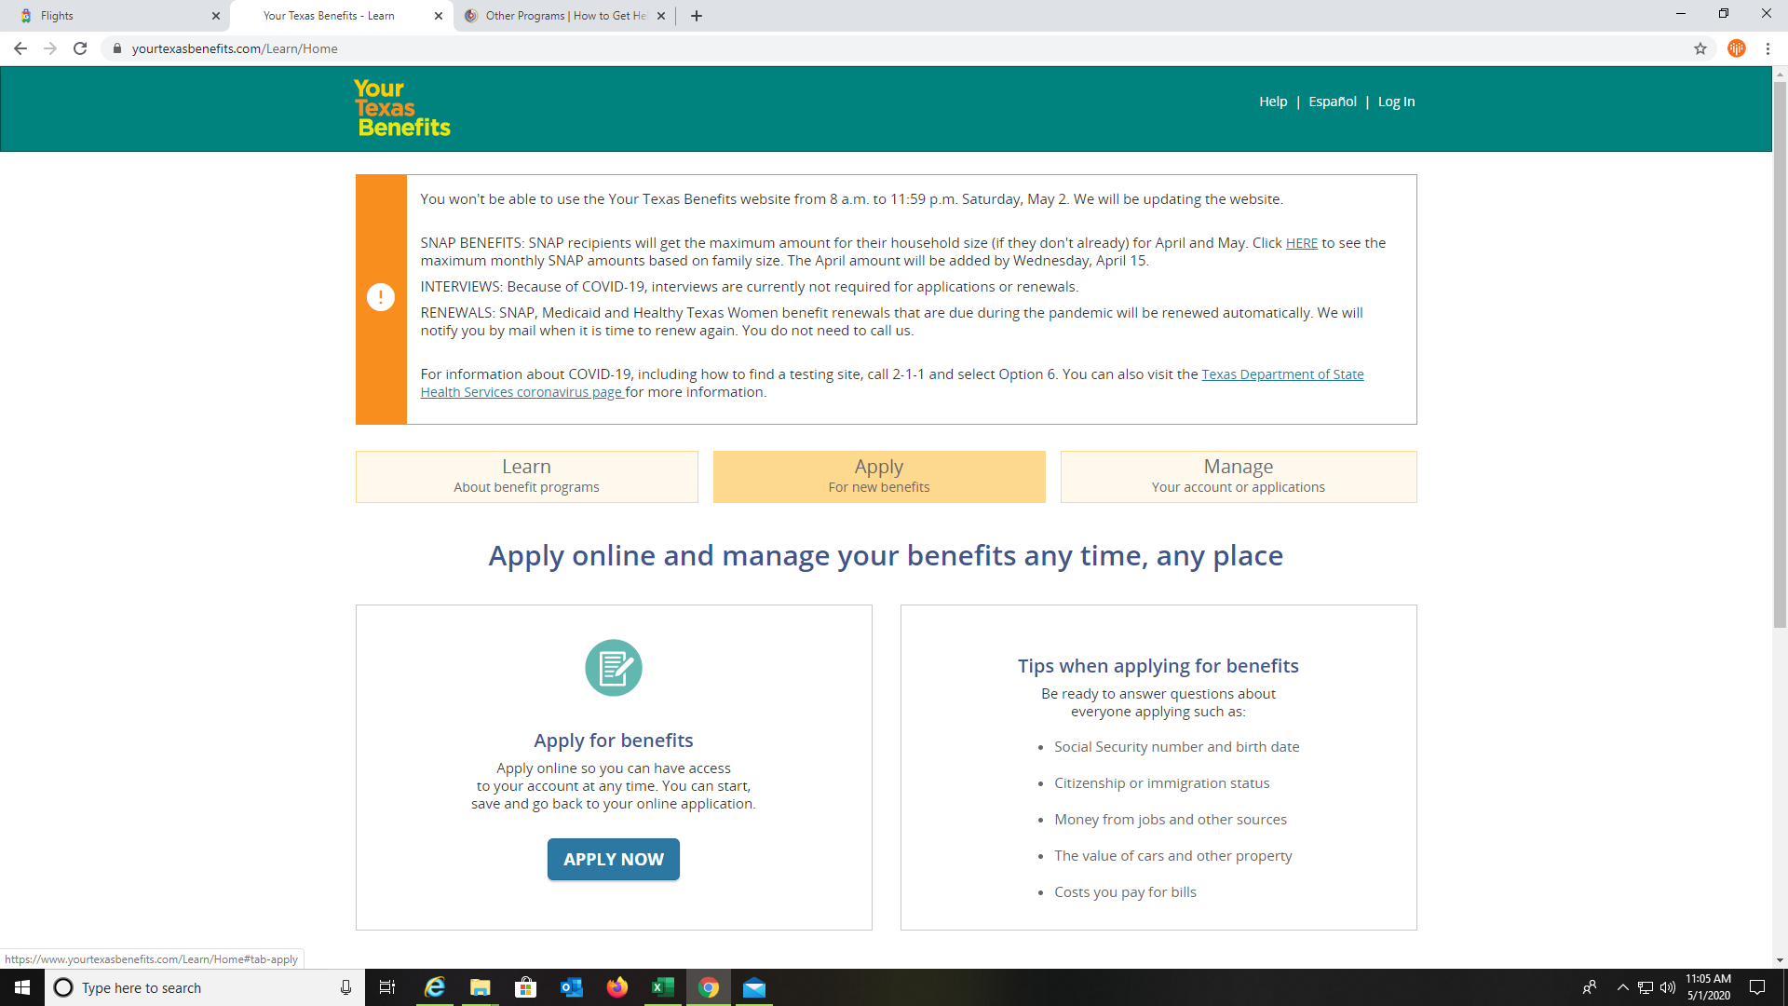
Getting Started..
https://www.yourtexasbenefits.com/Learn/Home
https://youtu.be/gpUxFnlkGhU, https://www.careconnection.org/
Signing on and creating an account with Your Texas Benefits is easy.
On your computer browser please type
https://www.yourtexasbenefits.com. The screen will look like the example to the left of the page. There are two options to apply for the benefits listed on the page. You will click on the yellow tab that says APPLY. Once you click the tab then a white box will appear with a blue tab APPLY NOW.

Slide 5
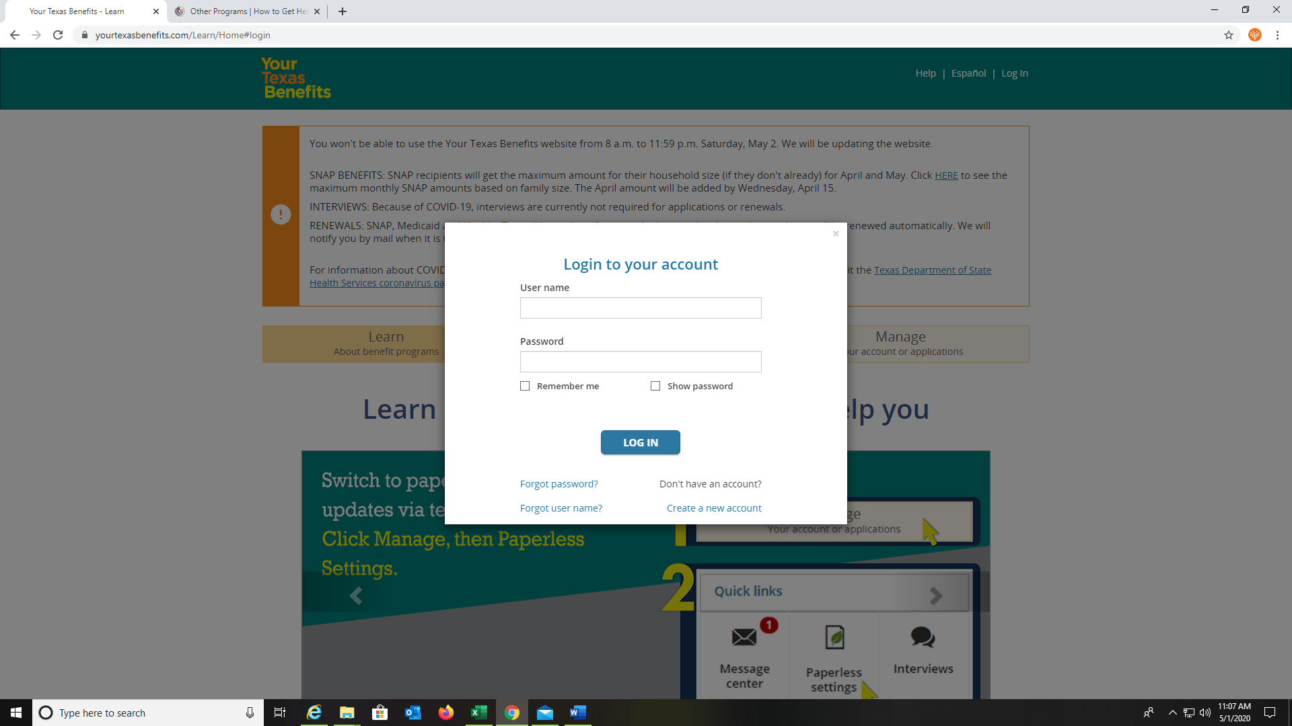
Let’s Take It Step By Step
https://www.yourtexasbenefits.com/Learn/Home
https://youtu.be/gpUxFnlkGhU, https://www.careconnection.org/
Signing on and creating an account with Your Texas Benefits is easy.
Once you have click on the APPLY NOW tab, a white box will appear asking you to log in to your account. If you have applied for benefits in the past, we highly recommend you log into that account. Your Texas Benefits will only allow you to link to one account. Select the Forgot Password and/or User Name to receive a new one. If you have never used this website before, please click on Create a New Account.

Slide 6
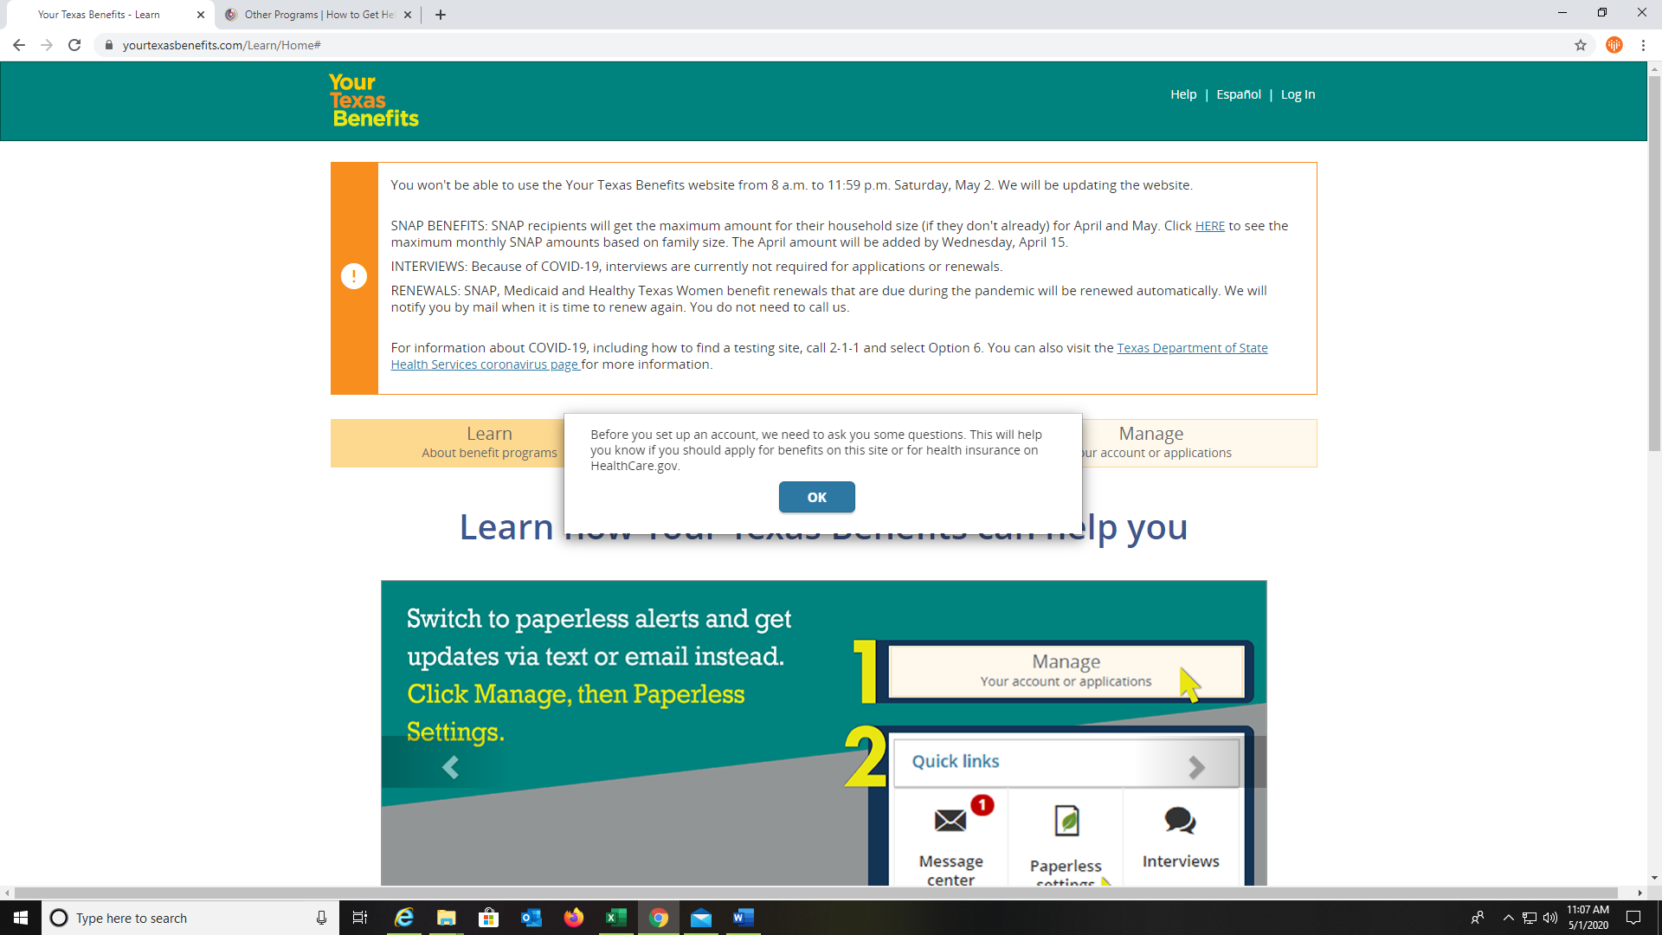
Creating a New Account
https://www.yourtexasbenefits.com/Learn/Home
https://youtu.be/gpUxFnlkGhU, https://www.careconnection.org/
Signing on and creating an account with Your Texas Benefits is easy.
After choosing to create a new account, this screen with appear. Please read the instructions carefully and proceed by clicking the OK button.

Slide 7
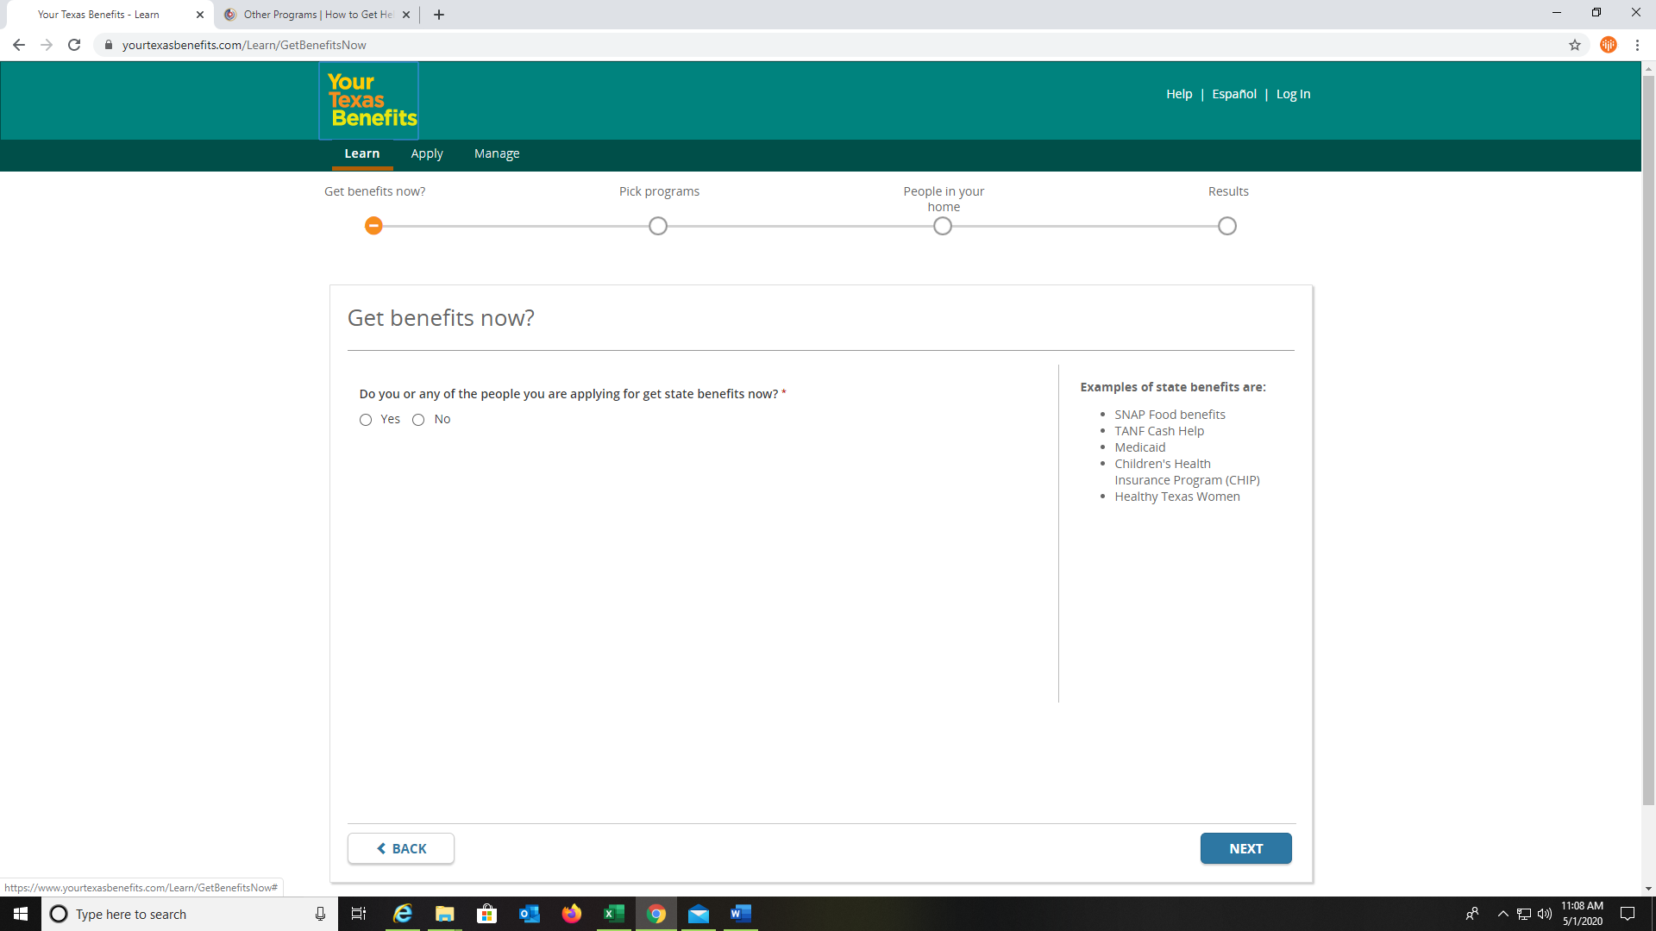
Creating a New Account
https://www.yourtexasbenefits.com/Learn/Home
https://youtu.be/gpUxFnlkGhU, https://www.careconnection.org/
Signing on and creating an account with Your Texas Benefits is easy.
On the Get benefits now? screen, you will be asked questions for the system to help guide you with setting up an account. Once you answer the questions on this screen, select NEXT to continue.

Slide 8
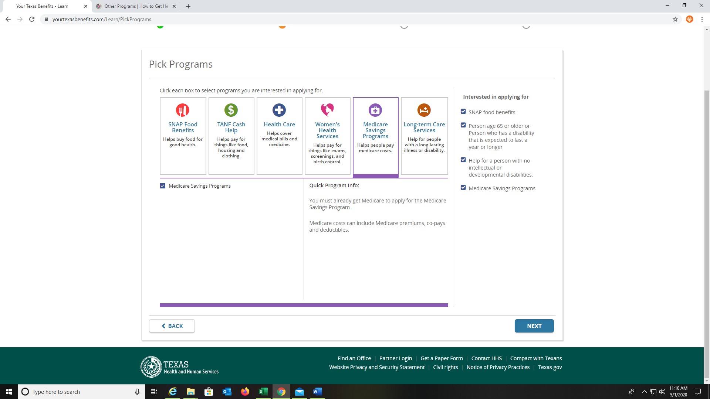
Pick a Program with Your Texas Benefits
https://www.yourtexasbenefits.com/Learn/Home
https://youtu.be/gpUxFnlkGhU, https://www.careconnection.org/
Signing on and creating an account with Your Texas Benefits is easy.
Please, take your time and read this screen carefully. The PICK PROGRAMS screen will give detailed information on all the benefits programs. A brief description and eligibility requirements are detailed for each program. Practice going to each option and reading the description so you can choose the best program for you. Once you have selected your programs, click the NEXT button to continue.

Slide 9
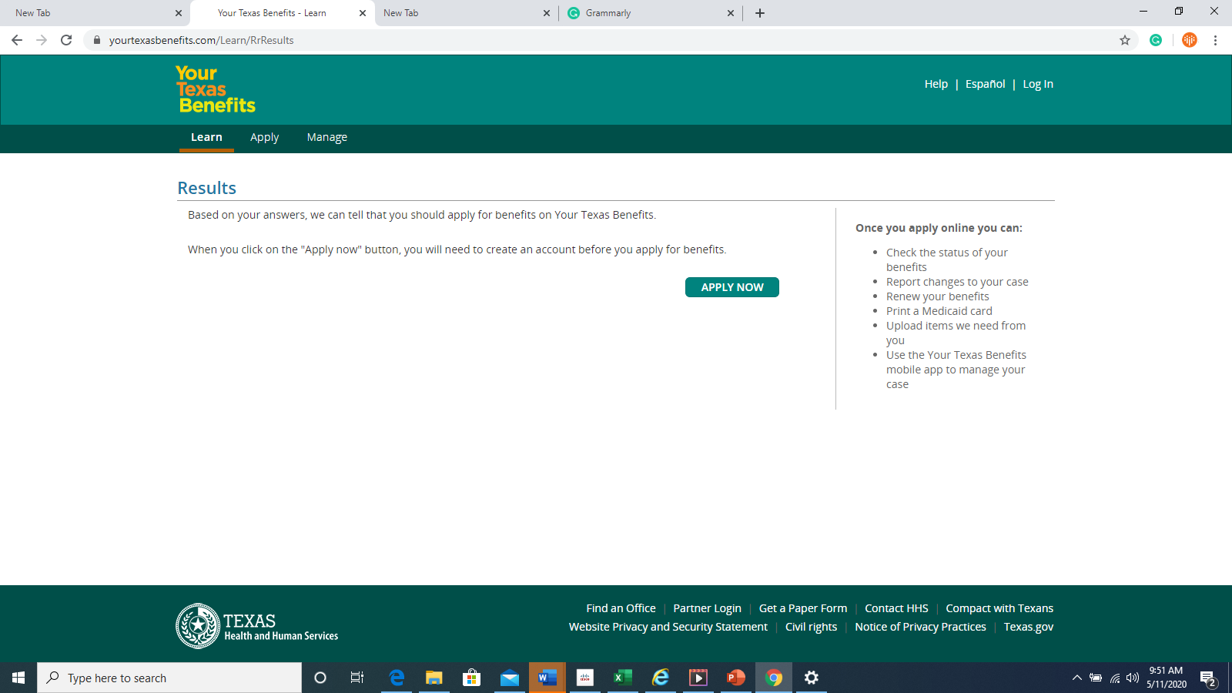
Next Steps
https://www.yourtexasbenefits.com/Learn/Home
https://youtu.be/gpUxFnlkGhU, https://www.careconnection.org/
Signing on and creating an account with Your Texas Benefits is easy.
The Results screen, lets you know that based on the questions that you answered, you should apply for benefits on the website. This step can be a little confusing because you have not completely set up your account yet. Click APPLY NOW once more and follow the steps.

Slide 10
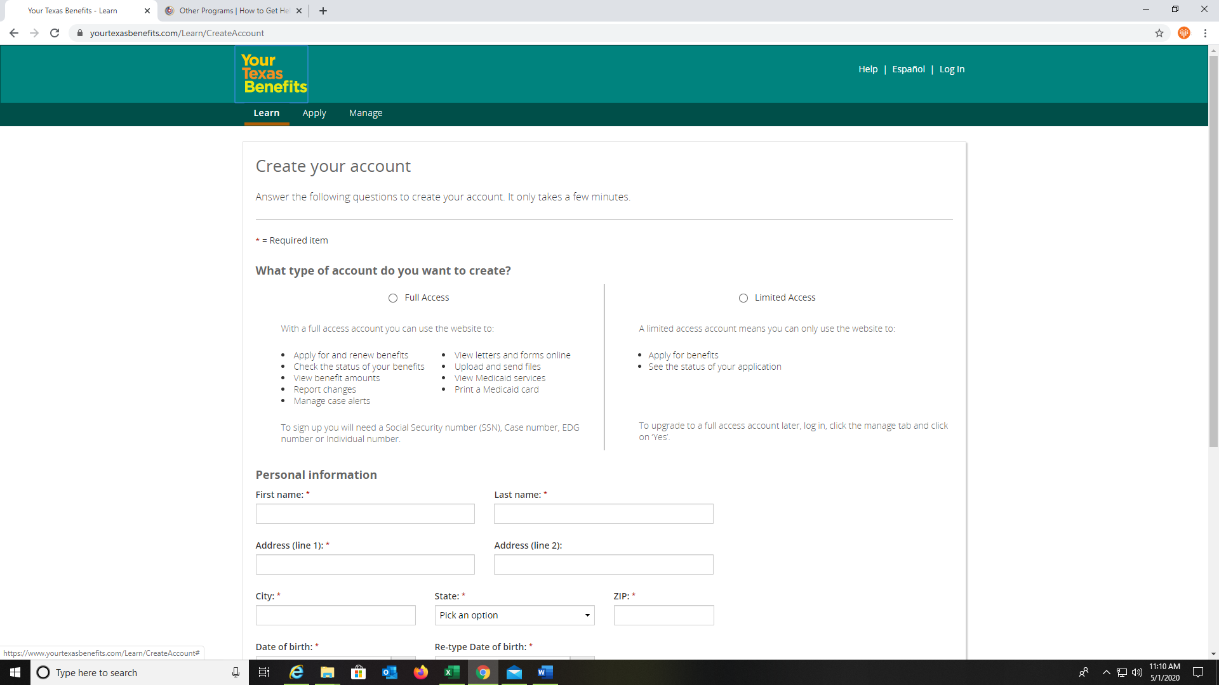
Creating Your Account…
https://www.yourtexasbenefits.com/Learn/Home
https://youtu.be/gpUxFnlkGhU, https://www.careconnection.org/
Signing on and creating an account with Your Texas Benefits is easy.
On the Create your account screen, you have two types of account options to choose from. There is FULL ACCESS and LIMITED ACCESS account feature. FULL ACCESS requires more verification information and you will have to wait up to 30 days for a social security number verification. LIMITED ACCESS will allow you to proceed with your current application and set up an account.

Slide 11
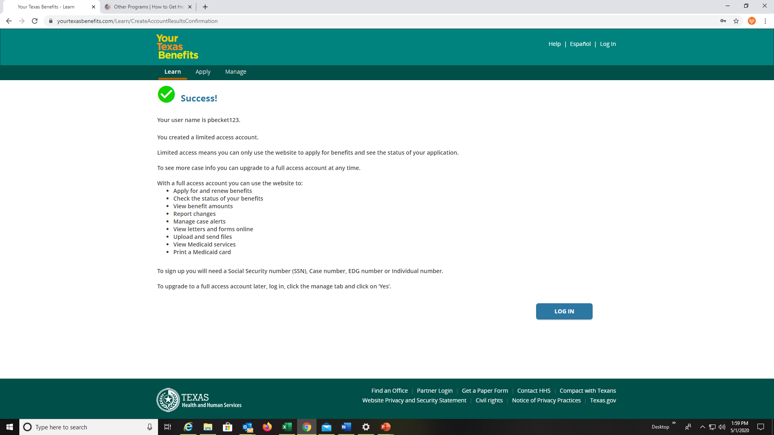
Creating Your Account…
https://www.yourtexasbenefits.com/Learn/Home
https://youtu.be/gpUxFnlkGhU, https://www.careconnection.org/
Signing on and creating an account with Your Texas Benefits is easy.
You need to create security questions and choose a user name and password. After you have completed those steps you will get a SUCCESS with a green checkmark, as you see to the left of the page. In the description of your account, it will be your access information. To start the application you will have to log in to the new account you have created.

Slide 12
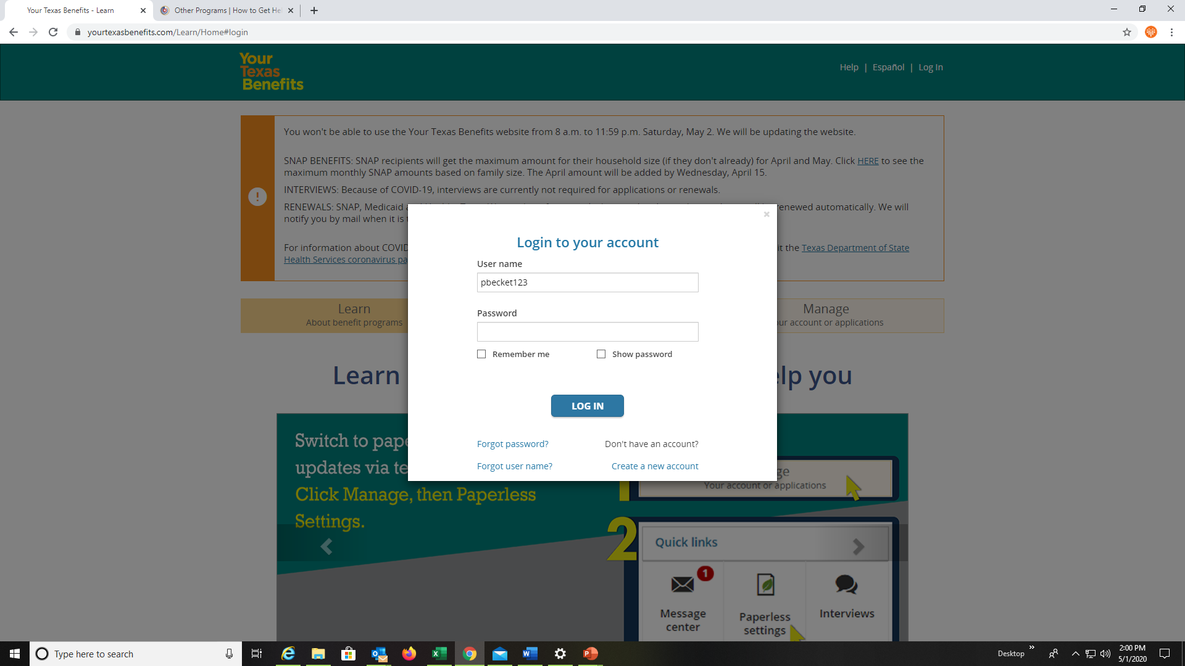
Starting a New Application…
https://www.yourtexasbenefits.com/Learn/Home
https://youtu.be/gpUxFnlkGhU, https://www.careconnection.org/
Starting a new application is easy on the YOUR TEXAS BENEFITS website.
Repeat the Apply Now steps and log into the account again. On this screen, you can also reset your password or user name if you forgot.

Slide 13
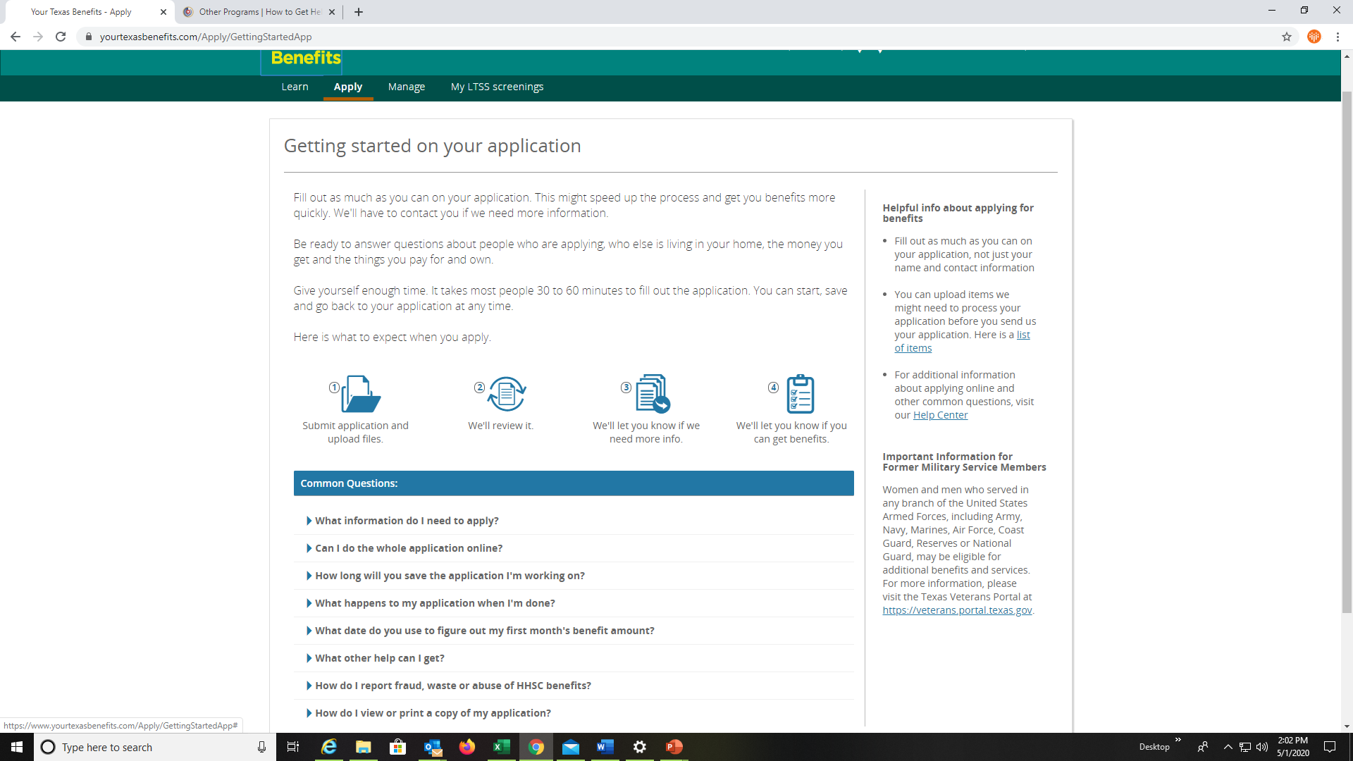
Getting started on Your Application
https://www.yourtexasbenefits.com/Learn/Home
https://youtu.be/gpUxFnlkGhU, https://www.careconnection.org/
Starting a new application is easy on the YOUR TEXAS BENEFITS website.
Getting started on your application, the screen will give instructions on how to upload documents, answer commonly asked questions, and give you the number and website to 211 for other resources.
www.211Texas.org. Once you reviewed all the information, please click on GET STARTED at the bottom of the page.

Slide 14
Getting Started with the Application
https://www.yourtexasbenefits.com/Learn/Home
https://youtu.be/gpUxFnlkGhU, https://www.careconnection.org/
Starting a new application is easy on the Your Texas Benefits is easy.
When setting up an account before, on the Pick Program screen your previous options are ported into your new application. Double-check and go over this screen, just to make sure you have applied for all the desired options. After you have reviewed your choices, click on the NEXT button to continue.

Slide 15
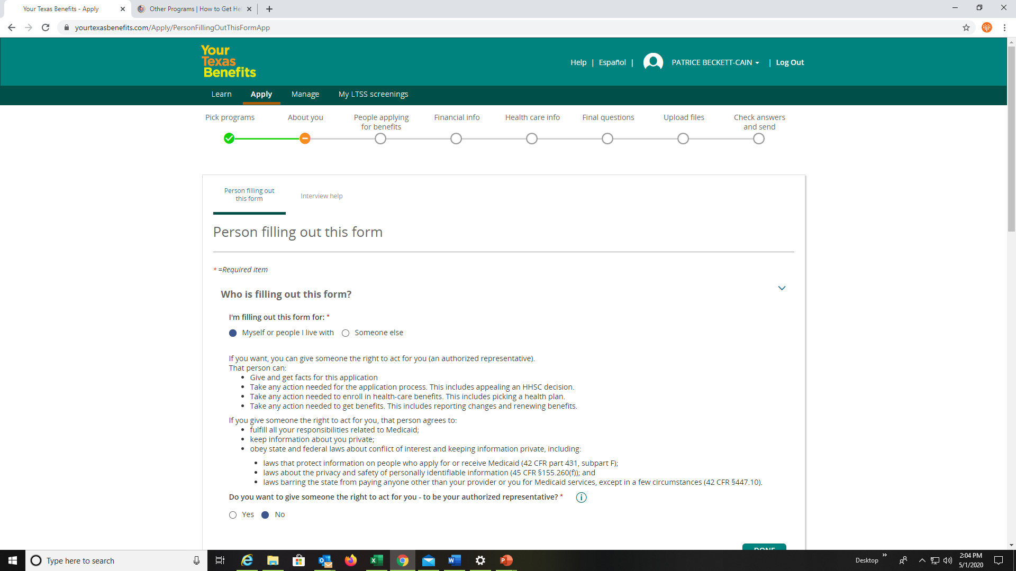
Getting Started with the Application
https://www.yourtexasbenefits.com/Learn/Home
https://youtu.be/gpUxFnlkGhU, https://www.careconnection.org/
Starting a new application is easy on the Your Texas Benefits is easy.
Now, you are ready to enter your information into your application. Please read all the questions on this page and provide the requested information accurately. If you are filling out the application on someone’s behalf make sure you read the information in the authorized representative section carefully. At the top of your screen, you will see where you are in the process, go step by step, and take your time.

Slide 16
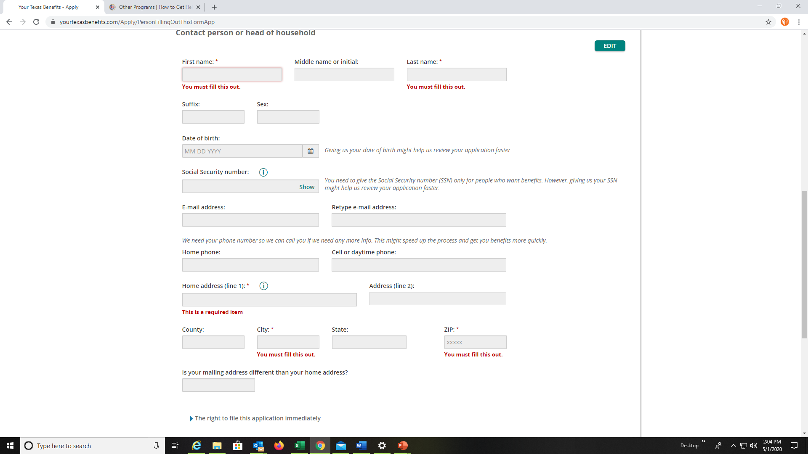
Completing the Application
https://www.yourtexasbenefits.com/Learn/Home
https://youtu.be/gpUxFnlkGhU, https://www.careconnection.org/
Starting a new application is easy on the Your Texas Benefits is easy.
Have the applicant's social security number, income, and any other information required to complete the application process. Please call the ADRC at 1-855-937-2372 if you experience difficulty navigating through the application process. If you experience any technical difficulties please call Your Texas Benefits at 713-957-4357 option # 2 for assistance with the application.

Slide 17
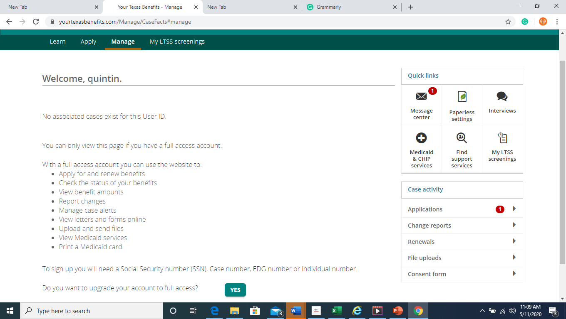
Managing Application and Status
https://www.yourtexasbenefits.com/Learn/Home
https://youtu.be/gpUxFnlkGhU, https://www.careconnection.org/
Managing a new application is easy on the Your Texas Benefits is easy.
Once you have completed the application and submitted it to your Texas benefits go to the Manage tab located at the top of your screen. In this tab you are able to view all the applications you have submitted, upload documents, messages, check on upcoming interviews, change account access, and case activity. Again, call 1-855-937-2372 if you need assistance with completing the application online. We will be happy to assist you.

Slide 18
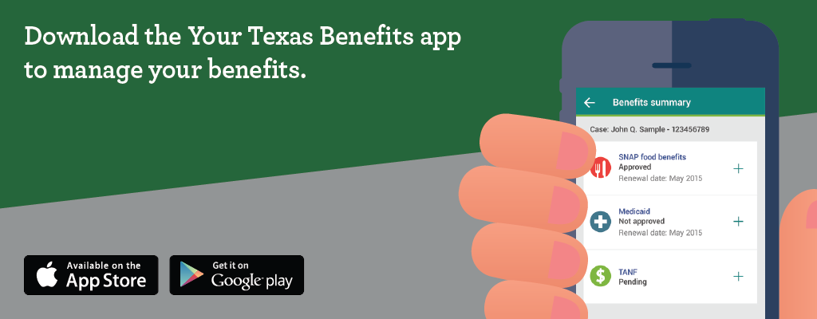
Don’t forget!! You can download the App for Your Texas Benefits on your smartphone.
Thank you for watching!

